Slide 1
SNF RRAM Standard Process Flow and Characterization of Lesker-2 TiN
ENGR241 Week 3 Updates
Project Members: Akash Levy, Jung-Soo Ko
Staff Mentors: Michelle Rincon, Vijay Narasimhan, J Provine, Usha Raghuram

Slide 2
Aim & Goals
Test and characterize ALD RRAM devices
Develop TiN recipe on new Lesker with low oxygen contamination
Compare TiN properties (composition, resistivity, topography)
Make electrical/imaging data and test structure layouts available to SNF
Make SOPs for RRAM stacks and report TiN findings
Process Flow Development
Parameter Optimization
Comprehensive Documentation
SNF Database

Slide 3

Tool Training Update
Finished training on:
Heidelberg
SVG Coat
SVG Develop
Thermco
Coming up:
XPS qualification (Thursday)
Almost done with training on tools! ☺
Need refresher on PT-Ox/PT-MTL though…

Slide 4
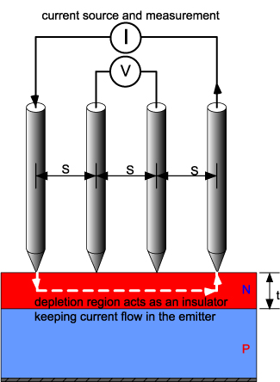
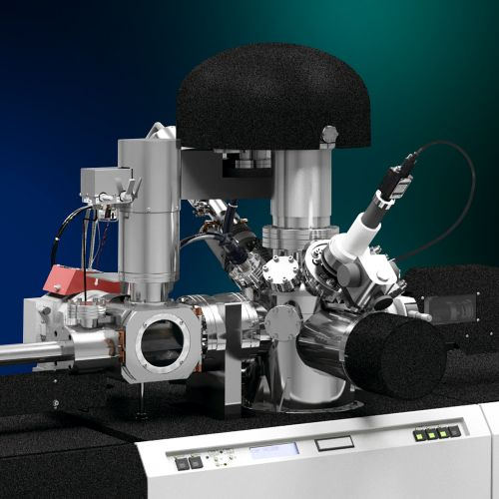
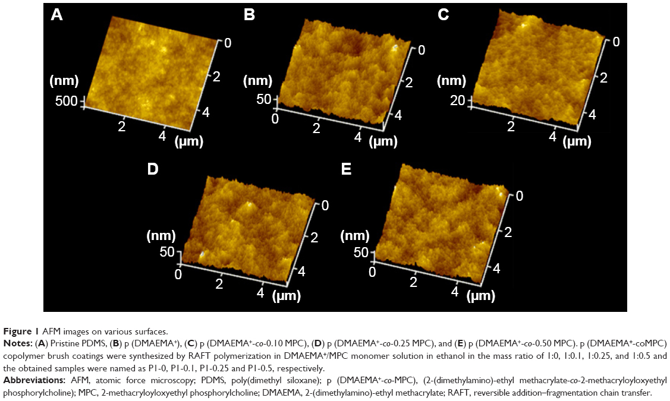
TiN Sample Preparation & Characterization
TiN
(Not drawn to scale)
SiO₂
SiO₂
Si
Si
Si
Start with Si wafer
Standard RCA Clean
Dry grow 100nm SiO₂
(thermco)
Sputter 30nm TiN
Compare 3 sputtering tools: Lesker-1 (SNF), Lesker-2 (SNF), AJA (non-SNF)
Prometrix Resistivity
XPS/Auger Composition
AFM Surface Roughness
AFM/Woollam
Step Height
Measure 3-4x throughout quarter to quantify oxidation over time

Slide 5
Progress Updates: Fabrication
Update: Lesker-2 expected to go live in early Feb.
RCA clean wafer
Woollam to measure native oxide thickness (11.2Å)
Dry oxide growth for 1hr in thermco4 @ 1100℃ (~100nm)
Woollam to confirm final oxide thickness (~1062.54Å, ~1052.91Å)
Exact thickness is not important, just there to insulate TiN from Si
Good quality oxide is important to get accurate TiN surface roughness
Sputter 30nm TiN (Kapton tape for step)
AJA (non-SNF)
Lesker-1 (SNF)
Lesker-2 (SNF)
Characterization
TiN
SiO₂
Si
Lesker TiN target

Slide 6
RRAM Process Flow Outline
SiO₂
SiO₂
SiO₂
(Not drawn to scale)
Pt
Pt
Si
Si
Si
Start with Si wafer
Standard RCA Clean
Deposit 30nm Pt,
100nm SiO₂ (AJA)
Pattern trenches (PT-Ox)
Clean sidewalls of trenches
Active device area
SiO₂
SiO₂
SiO₂
SiO₂
SiO₂
SiO₂
TiN
TiN
HfO₂
HfO₂
HfO₂
Pt
Pt
Pt
Si
Si
Si
Pattern top electrodes
(PT-MTL)
Sputter 30nm TiN
Deposit 10nm HfO₂ (Fiji)

Slide 7
Process Flow Parameters
Resistive switching material (metal oxide): hafnia, alumina, zirconia, tantala, titania
Seed layer: none, 1nm, 2nm
Dimensions:
TiN electrode thickness: 5nm, 10nm, 20nm, 30nm, 50nm
Resistive switching layer thickness: 2nm, 5nm, 8nm, 10nm, 15nm
Device size: ﻿{1, 2, 3, 4, 5, 8, 10, 20, 40, 50} um
RS oxide growth temperature: 200C, 250C, 300C
Anneal temperature: none, 300C, 400C
Metal oxide ALD method: plasma, thermal
Theory: thermal ALD will work better since plasma is known to cause interface traps and can also potentially sputter BE metal
TiN deposition method: ALD vs. sputtered
Theory: ALD TiN will not work because of oxygen contamination
Optimize (sputter): substrate bias, temperature, sputtering gases, etc.
Top contact: Au, Ag, TiN only

Slide 8
Progress Updates
Finalized most of the process flow details and single device array layouts!
RCA clean wafer
Deposit 10nm Ti with AJA (skipped)
Deposit 30nm Pt with AJA
Deposit 100nm SiO2 with AJA
Woollam to check oxide thickness (834Å, 21.33 MSE)
Photolithography
YES Oven for 30 mins
SVG Coat 2 with 1µm Shipley 3612 resist, 2mm EBR, skip prime step
Expose with Heidelberg: look at previous runs, logbook, exposure charts next to tool (dose: 80, defocus: ±2?)
SVG Develop (1µm 3612 dev) w/post-exposure bake and inspect
PT-Ox: 1700 Å/min (look at monitor log), so etch for ~45 seconds: jkPRmask OxSTD, seO2Clean-1
Matrix for resist ashing: use defaults (Strip.rcp 120s) and inspect to see if resist is removed
Fiji1 thermal HfO₂: 100 cycles standard recipe
Woollam to check oxide thickness
TiN deposition 30nm
Photolithography (see previous steps)
PT-MTL: still need details
Matrix for resist ashing: use default recipe (Strip.rcp 120s) and inspect to see if resist is removed
(Should we worry about TiN oxidation from oxygen plasma?)
Just finished litho training!
Hoping to get here by next Tuesday

Slide 9
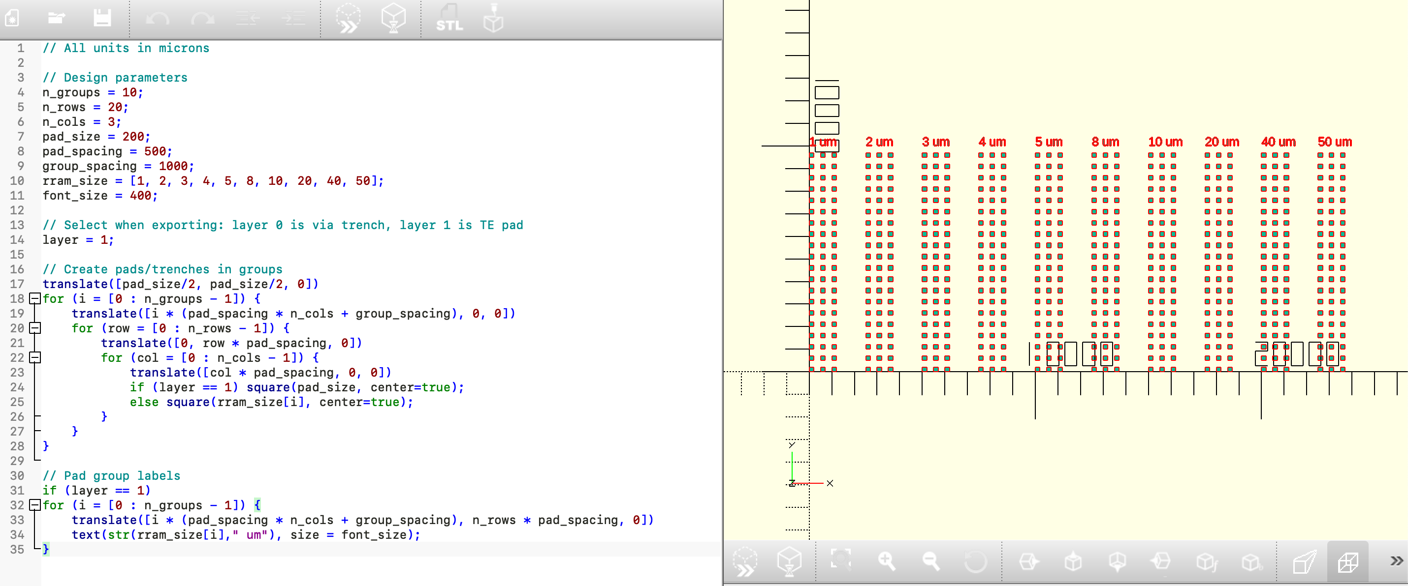
Layout Generator

Slide 10
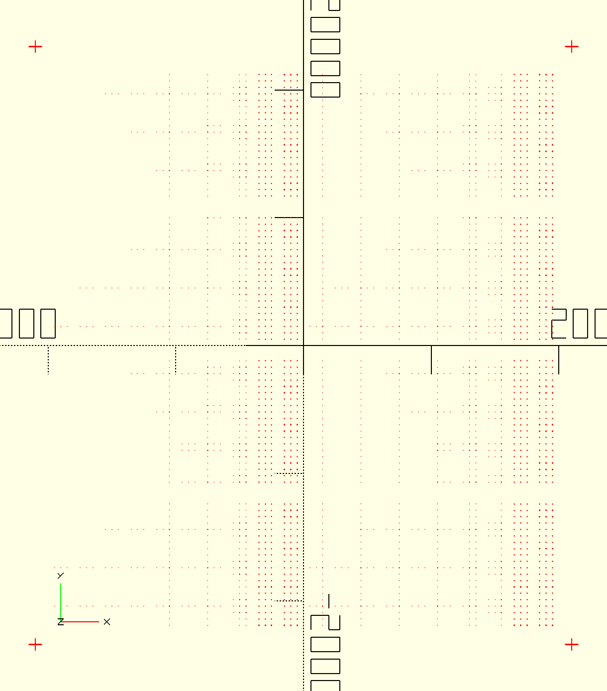
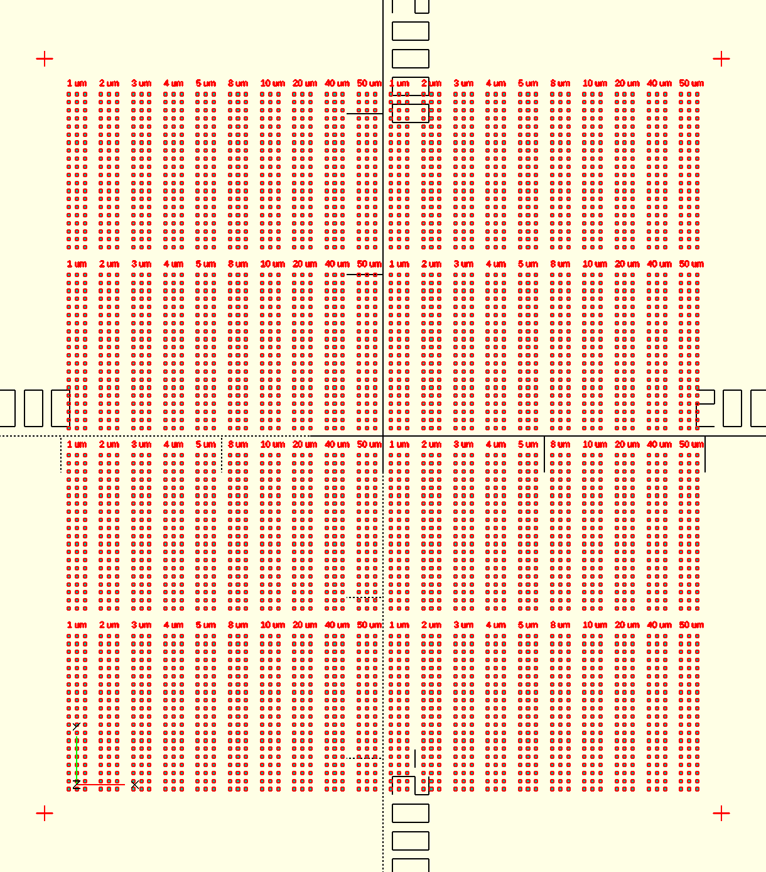
Layout Generator
Trench Layer
Top Electrode Layer
Finalized layout: alignment marks, tiling, centering about origin to make Heidelberg usage easier
Design dimensions: about 4cm x 4cm, (20x3 array) x (4x2 grid) devices per size with 10 device sizes

Slide 11
Characterization for this week
2 samples
AFM step height
-surface roughness (sio2, tin)
-step height (tape)
(will do ellipsometry for comparison)
Auger
-composition
Prometrix training → Ask marc for help
(eventually get trained on it)

Slide 12
Thank you!
Questions?

